Slide 1






Mansi Mehrotra
University of Pune, India, BE in Computer Science
VIU, Technical Product Management
University of Washington, MS Information Management
Starbucks, Business Intelligence
Adobe, Business Intelligence
Fred Hutch, Data Science Fellow
Theriot Lab, Data Engineering

Slide 2
Goals
Generate visualization tools for the exploration of large-scale datasets.
To build a cloud infrastructure that can scale up a pipeline to process large, biological image data sets.

Slide 3
Goal 1 – Information Visualization
59
50
40
30
20
10
00
Number of cells per field of view in one well
Notes:
Overall, a pretty good dispersal of cells in the well.

Slide 4
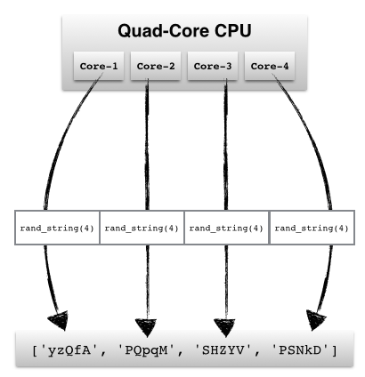
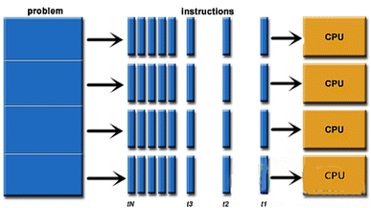
What is Parallelization?
Parallelization is the act of designing a computer program or system to process data in parallel.^{[1]}
Experimented with 2 ways of achieving parallelization:
Multi-processing: Multiple cores in the same computer(CPU) work on one or more task
Parallel Computing: Multiple CPUs running a single program in parallel
Parallel Computing is preferred to prevent a single point of failure.
^{[1]}https://www.computerhope.com/jargon/p/parallelization.htm
Fig. 1: Multiprocessing
Fig. 2: Parallel Computing

Slide 5
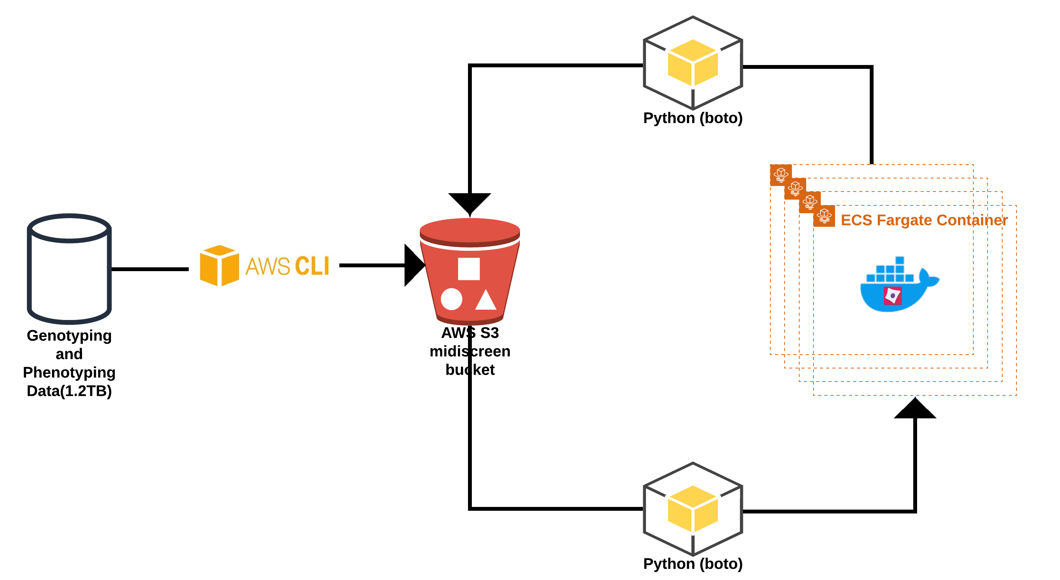
Goal 2 – Building a Computational Infrastructure
SERVICE | FUNCTIONALITY | SERVICE DETAILS
ECS Fargate/EC2 | MUST HAVE | Compute
Amazon S3 | MUST HAVE | Image Storage
AWS Aurora | OPTIONAL | Relational Database
Amazon EMR | OPTIONAL | Data Analysis
Amazon SageMaker | OPTIONAL | Machine Learning
Notes:
Demonstrate with mouse movement
Top right: Run any py script for ph. And gen. images
Bottom right: Processing with parallelization
We’ve also learnt a bit about the pros and cons of using RDBMS but I’m happy to elaborate on it if there’s any questions about it.
Mention each service is AWS and what is AWS – Amazon has a suite of services that cater to our needs of our application.

Slide 6
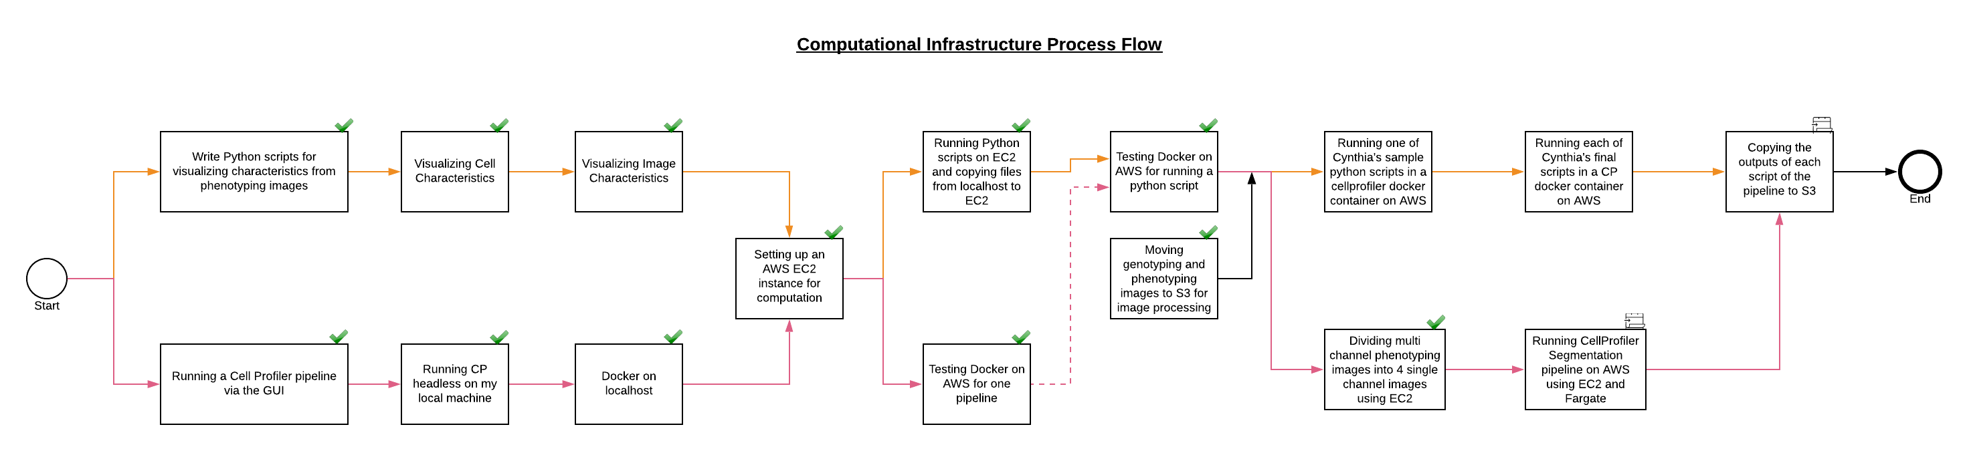
Task Roadmap to build Infrastructure
Pipeline Sub-part 1:
Barcode Calling from Genotyping Images and shape analysis from Phenotyping Images using custom python scripts
Pipeline Sub-part 2:
Cell Segmentation from Phenotyping Images using Cell Profiler
Notes:
Summarize where we are right now.
We can now run python script using multiprocessing and are currently in the process of implementing these through parallel computing.

Slide 7
Effect of Parallelization on Computation Time
Use Case: Splitting a multi-channel image into 4 single-channel images for 38,400 phenotyping fields of view.
 | Multiprocessing | CPU | Download from S3 (611.6 GB) | Intermediate Processing | Upload to S3 (292.31GB) | Total
Projected Time from a sample of 33 FOV | No | localhost | 15.02 hours | 1.35 hours | 81.24 hours | 97.62 hours
 | Yes | localhost | 68.09 hours |  |  | 68.09 hours
Actual Time on entire dataset | Yes | AWS EC2 | ~6 hours |  |  | ~6 hours
Notes:
Explain why we are we running this script and why are we looking at computation time.
Use mouse hover
Walk through all 3 steps: d/w, inter, u/l
Mention how many images -> 33 to 38400 images

